Slide 1
The art and science of developing interesting solutions for the human oriented improvement of society, ecosystems, information technology, and actionable insightful synergistic reformation of culture, or the spicy tomato five for short.
We hope you make it!
Asa Brown, Calder Furminger, Daniel Sterne, Jacob Roberts, Wyatt Roberts.

Slide 2
Our topic: course registration SUCKs
This is a real issue that effects real people
We talked with several students about how to improve it
Common topics included:
  Needing to open two tabs to see current and prospective courses
  Advising is helpful but inconvenient
  Personalized course sequence planning
  Prerequisites and other relevant course information not visible

Slide 3
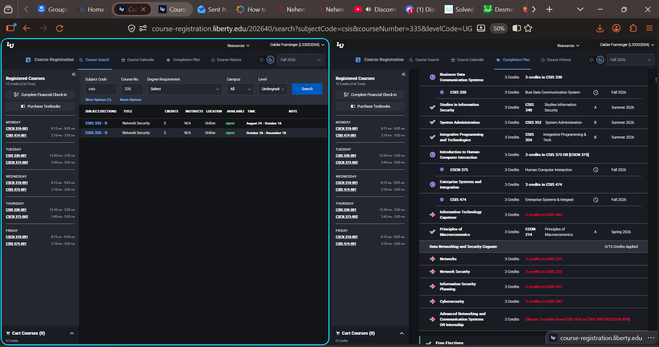
Multi-screen functionality

Slide 4
Put image of our splitscreen here

Slide 5
AI advisor (hallucinations don’t exist what are you talking about)

Slide 6
Customizable course planner software!
May make students more likely to remain with/choose LU

Slide 7
More course information, and how to manage it!

Slide 8
Live Demo
Link goes here [have a live server that they can play around with but that we also then tab over to]

